Slide 1
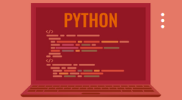

CWCT 140
Professor David Lieberman
dlieberman@ivytech.edu

Slide 2
Agenda
String Methods
Object Oriented Programming
Brief Introduction to Classes
Exceptions
Web Scraping
Programming Assignment

Slide 3
String Methods
capitalize() – changes all string letters to capitals;
center() – centers the string inside the field of a known length;
count() – counts the occurrences of a given character;
join() – joins all items of a tuple/list into one string;
lower() – converts all the string's letters into lower-case letters;
lstrip() – removes the white characters from the beginning of the string;
replace() – replaces a given substring with another;
rfind() – finds a substring starting from the end of the string;
rstrip() – removes the trailing white spaces from the end of the string;
split() – splits the string into a substring using a given delimiter;
strip() – removes the leading and trailing white spaces;
swapcase() – swaps the letters' cases (lower to upper and vice versa)
title() – makes the first letter in each word upper-case;
upper() – converts all the string's letter into upper-case letters.

Slide 4
String Methods
endswith() – does the string end with a given substring?
isalnum() – does the string consist only of letters and digits?
isalpha() – does the string consist only of letters?
islower() – does the string consists only of lower-case letters?
isspace() – does the string consists only of white spaces?
isupper() – does the string consists only of upper-case letters?
startswith() – does the string begin with a given substring?

Slide 5
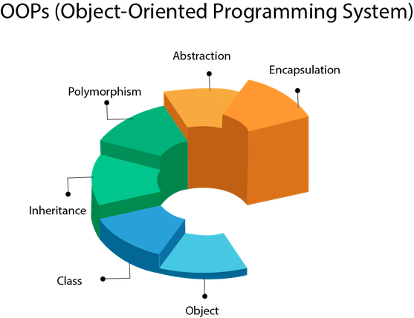
These features are predominant in OOP languages:

Slide 6
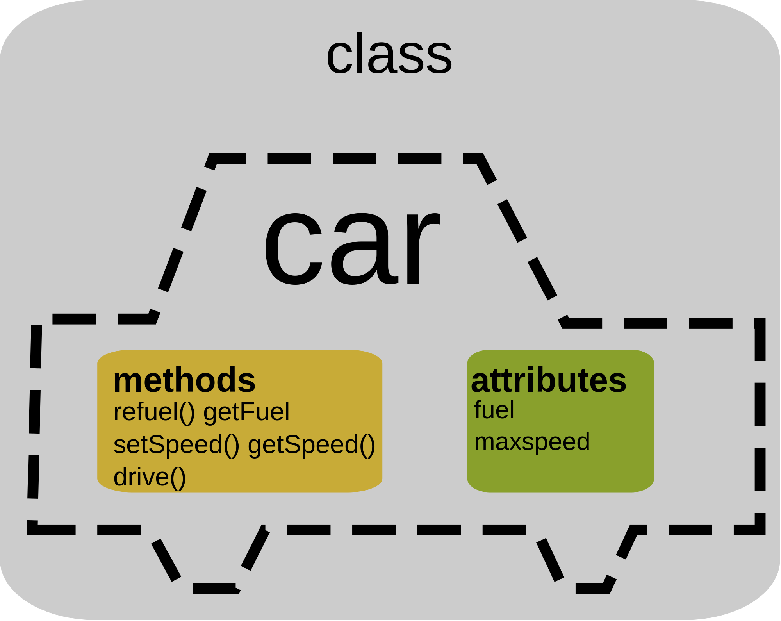
Classes
A class is a template (or blueprint) from which objects are created. For example, a “Dodge” object could be created from a “Car” class

Slide 7
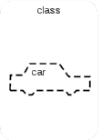
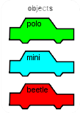

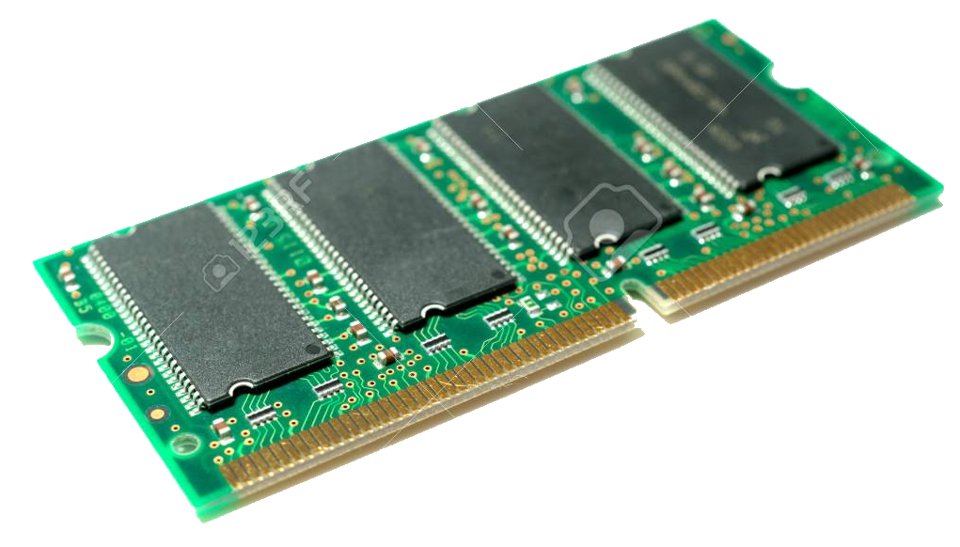

Objects - Instantiation
Objects must be “instantiated”. This is a fancy word meaning – “allocating memory for the object”.

Slide 8
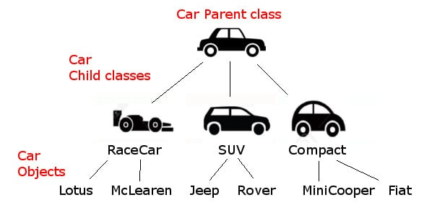
Inheritance
Inheritance is the ability to extend the blueprint (class). As an example, a RaceCar class may be derived from the Car class

Slide 9
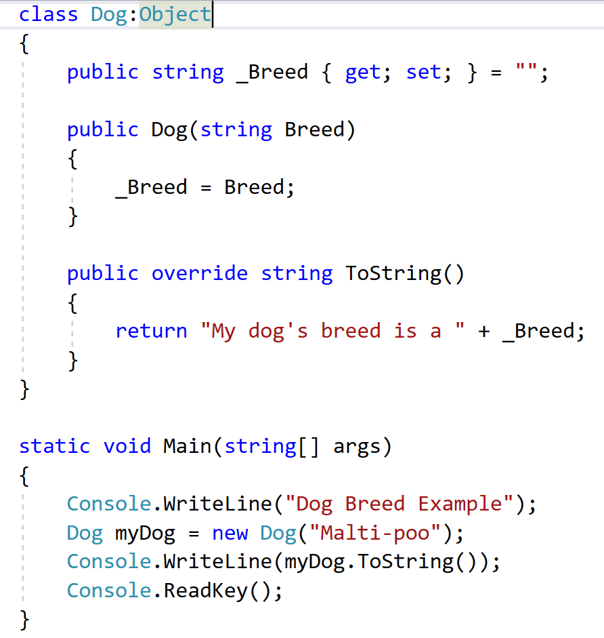
C# Example
Inheritance
Accessor
Overloaded Constructor
Abstract Method Overridden
Instantiation

Slide 10
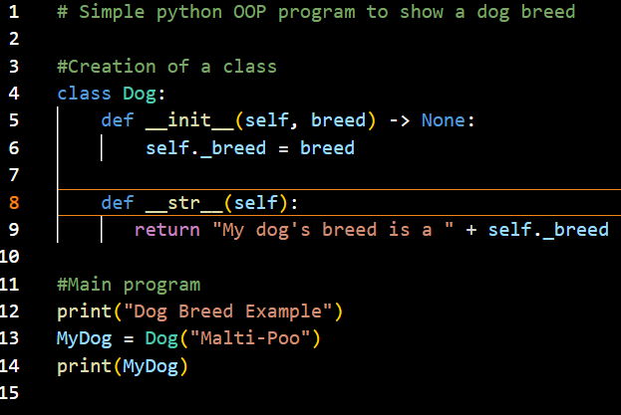

Simple Python Example
Overloaded Constructor
Method Overridden
Instantiation

Slide 11
Exception Handling
# Exception handling
a = 0
b = 2
try:
c = b / a
except Exception as e:
print("I caught the exception: ", e)

Slide 12
Exception Handling
# Exception handling
import math
a = 0
b = -2
try:
c = math.sqrt(b)
except ZeroDivisionError:
print("I captured a division by zero error")
except ValueError:
print("I captured a math error")

Slide 13
Custom Exception
# Custom Exception Class – Inherits from Exception
class NotAlphanumericError(Exception):
def __init__(self):
print("Error: A non-alphanumeric character was detected")

Slide 14
Custom Exception
# Custom Exception -- input validation
def GetUsername():
username = input("Please enter a username: ")
if username.isalnum():
return username
else:
raise NotAlphanumericError
# Main program -- get a username
print("Account Login")
while True:
try:
user = GetUsername()
break
except Exception as e:
print(e)
print("User \"" + user + "\" logged in successfully.")

Slide 15
Web Scraping
import requests
page = requests.get("https://dataquestio.github.io/web-scraping-pages/simple.html")
print (page.status_code)
print (page.content)
import requests
from bs4 import BeautifulSoup
page = requests.get("https://dataquestio.github.io/web-scraping-pages/simple.html")
soup = BeautifulSoup(page.content, 'html.parser')
print(soup.prettify())

Slide 16
Programming Assignment
With all program submissions you need to include screenshots illustrating your programs ran successfully.
All program submissions require a header comment containing your name, course, date, program name, and a description of the program.

Slide 17
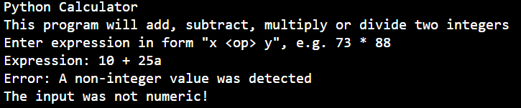
Assignment
The main portion of a "calculator" program is shown below. Add a custom exception class for "NotNumericError" and the function for GetNumber() so that the Main program produces the following output:

Slide 18
Assignment
print("Python Calculator")
print("This program will add, subtract, multiply or divide two integers")
print("Enter expression in form \"x <op> y\", e.g. 73 * 88")
calcmessage = input("Expression: ")
parameters = calcmessage.split()
try:
value1 = GetNumber(parameters[0])
operator = parameters[1]
value2 = GetNumber(parameters[2])
except NotNumericError:
print("The input was not numeric!")
exit()
if operator == "+":
result = value1 + value2
elif operator == "-":
result = value1 - value2
elif operator == "*":
result = value1 * value2
elif operator == "/":
result = value1 / value2
print(value1, " ", operator, " ", value2, " = ", result)

